Slide 1
Heart Failure Prediction
Presenter:
Yifeng Lin
Yuan Zheng
Ziyang Guo

Slide 2
Intro & Abstract
This project is about using different machine learning models to predict the heart failure based on other biological information to check which model has the best performance. The model we select out can be a good tool for people who want to predict their possibility to get cardiovascular diseases. The dataset is sourced from Kaggle.com. It includes 918 observations and contains 11 features that can be used to predict a possible heart disease. Due to there are more and more people have regular physical examinations but the number of people suffering from CVDs is still increasing year by year.

Slide 3
Research Questions:
What biological attributes can help us to construct machine learning models that can predict whether we have cardiovascular disease or not?
Which model is the best model to predict whether we have cardiovascular disease or not?
Notes:
, so that we come up with 2 research questions based on the data we have now.
Q1: What biological attributes can help us to construct machine learning models that can predict whether we have cardiovascular disease or not?
Q2:Which model is the best model to predict whether we have cardiovascular disease or not?

Slide 4
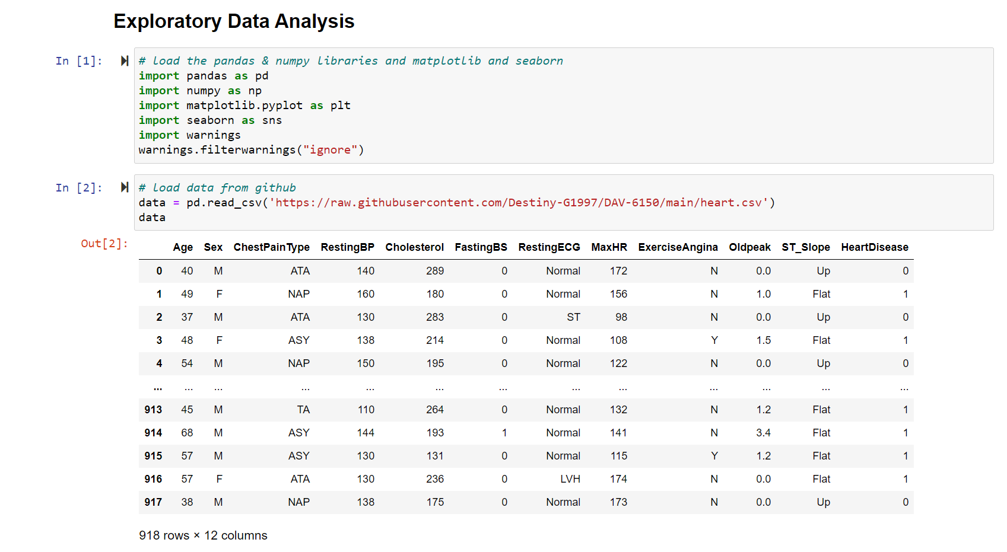
EDA
Notes:
First, we import our data and libraries we will use in further steps

Slide 5
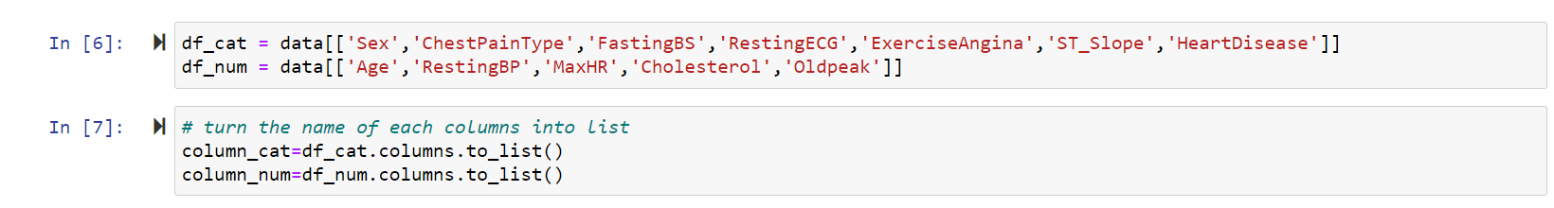
EDA
Notes:
We first separate categorical data and numerical data into 2 lists.

Slide 6
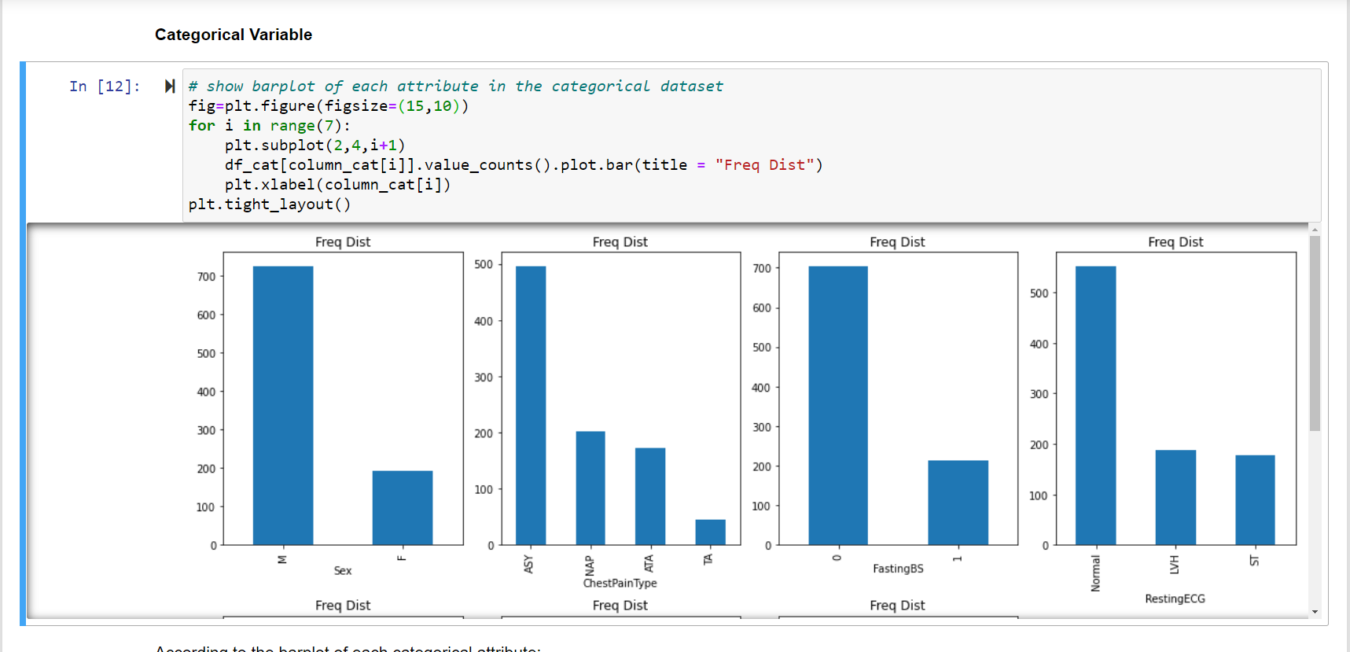
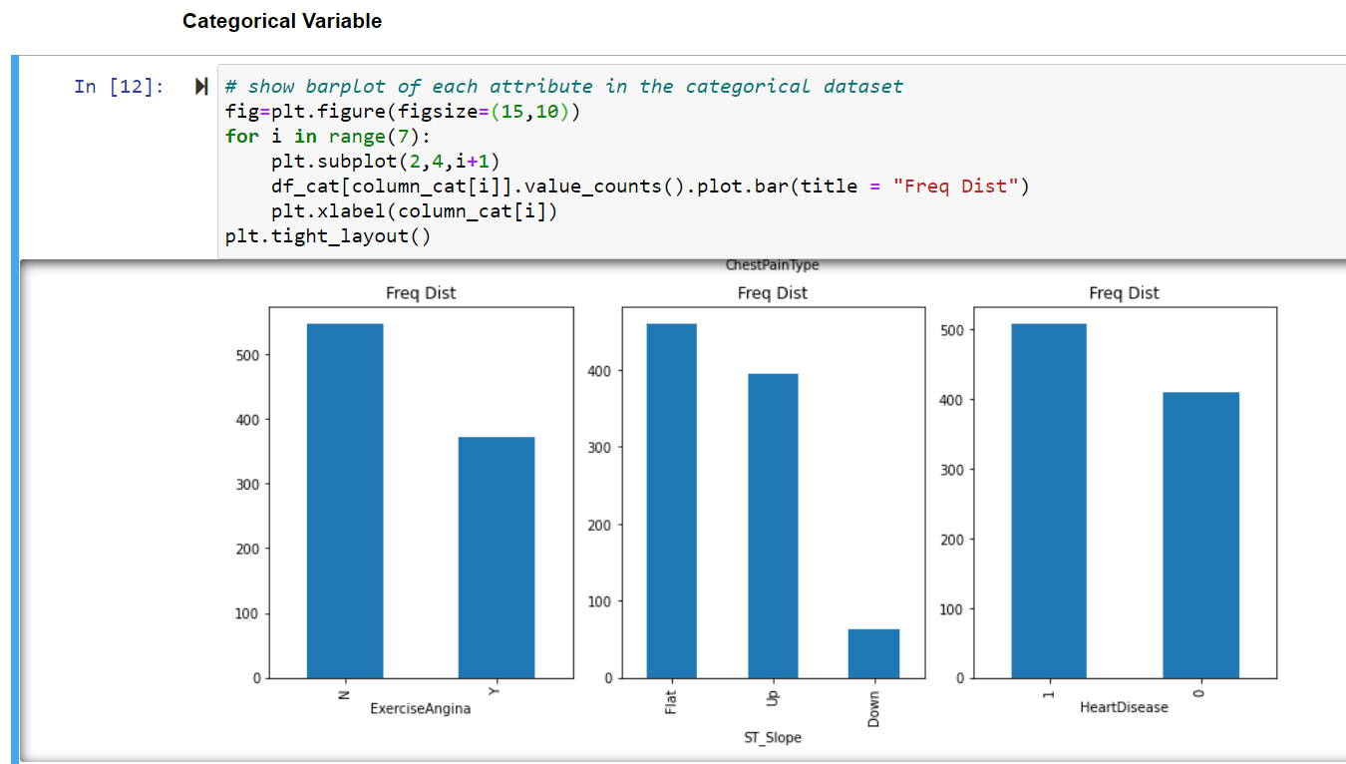
EDA
Notes:
Then we finished the analysis separately.
According to the According to the barplot of each categorical attribute: Sex: M = Male, F = Female. M:F nearly equal to 8:2. ChestPainType: There 4 types of chest pain type. The ASY are the most common type in the dataset. FastingBS: '0':'1' nearly equal to 7:3. It means most people have normal fasting BS. RestingECG: There 3 types of resting ECG. Most of people has normal resting ECG. The number of people who have LVH type of resting ECG are nearly equal to the number of people who have ST type of resting ECG. ExerciseAngina: The number of people don't have exercise-indeued angina is more than the number of people who do. ST_Slope: There are 3 types of ST_Slope. There are more people who have flat or up ST_Slope. HeartDisease: The response variable. The number of people who have cardiovascular diseases are more than the number of people who don't. Due to 'ST_Slop', 'ExerciseAngina', 'RestingECG', 'ChestPainType', and 'Sex' are nominal categorical variables, so we will transiform them into dummy variables in below data preparation.

Slide 7
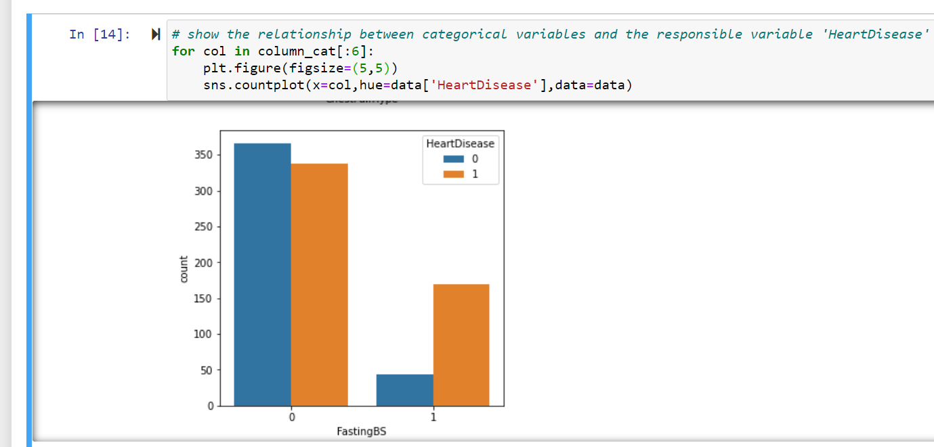
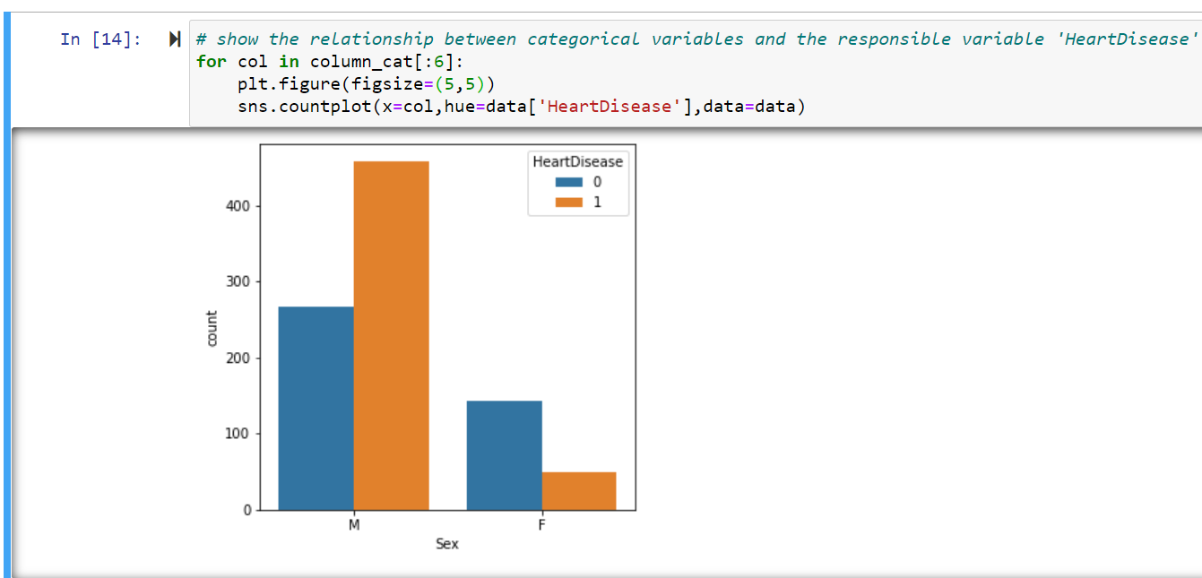
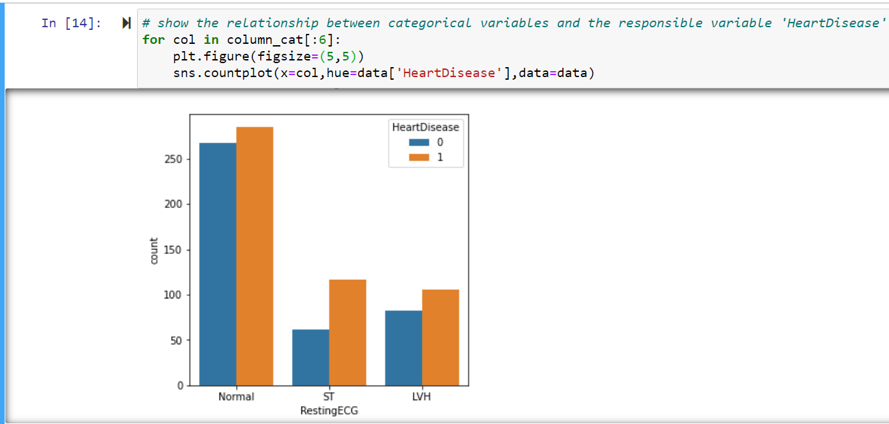
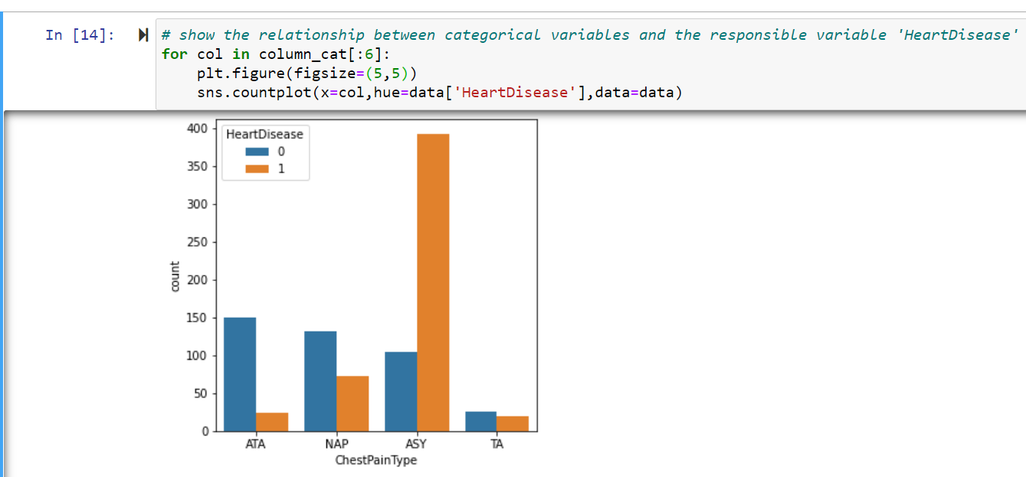
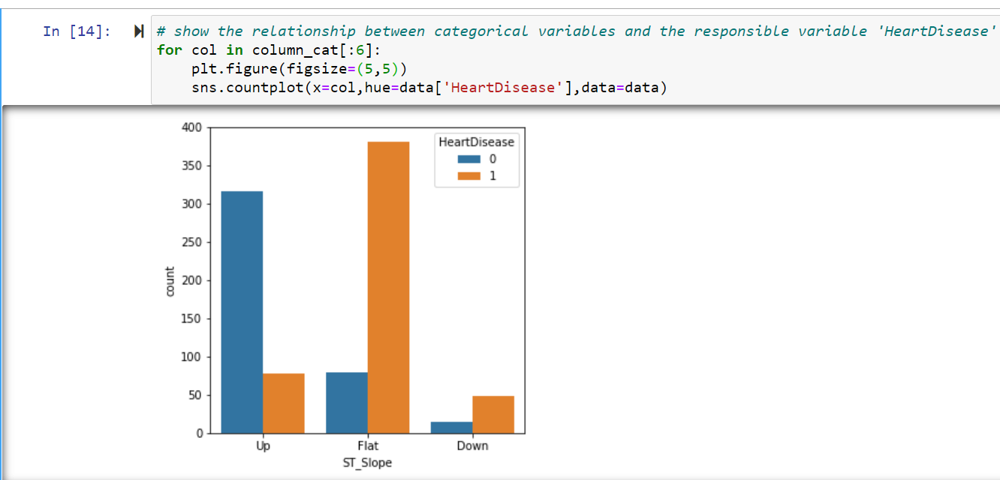
EDA
Notes:
We also made a countplot to show the relationship between categorical variables and the responsible variable 'HeartDisease' . According to the countplots, the 'Fasting BS' obviously has less '1', and the 'HeartDisease' has nearly equal to 0 and 1 when 'Fasting BS' equals to 0, so that may mean the 'Fasting BS' may not be any key indicator that can lead to cardiovascular diseases. The Male are more likely to have cardiovascular diseases than females. The ASY chest pain type is more likely to lead to cardiovascular diseases. Three 'Resing ECG' types don't have a significantly different impact on leading cardiovascular diseases. People who have exercise-induced angina are more likely to have cardiovascular diseases. The Flat and Down 'ST_Slope' ARE more likely leading to cardiovascular diseases.

Slide 8
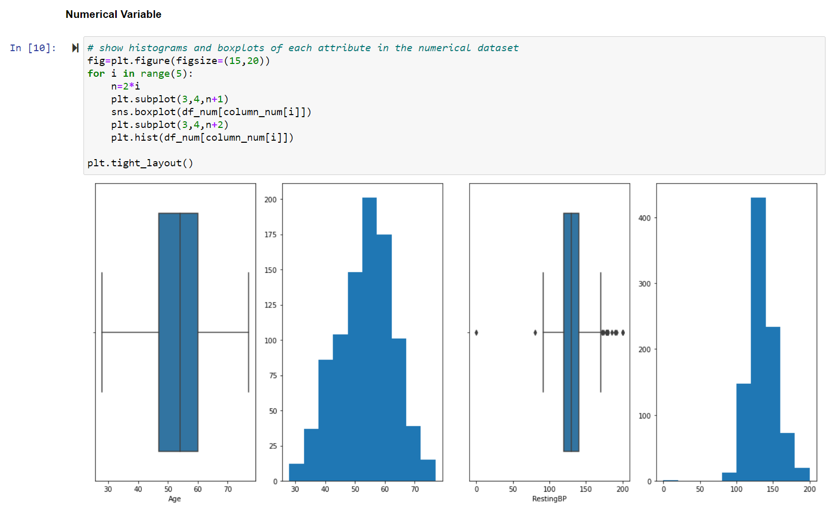
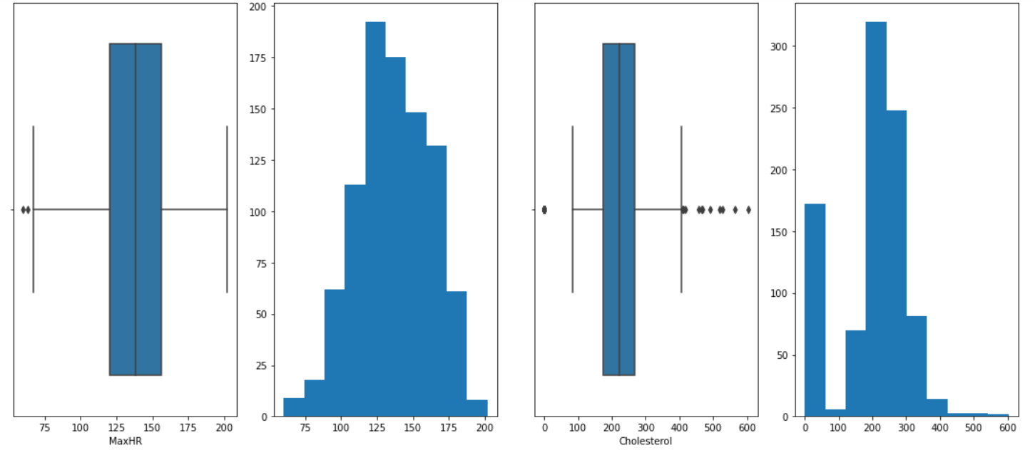
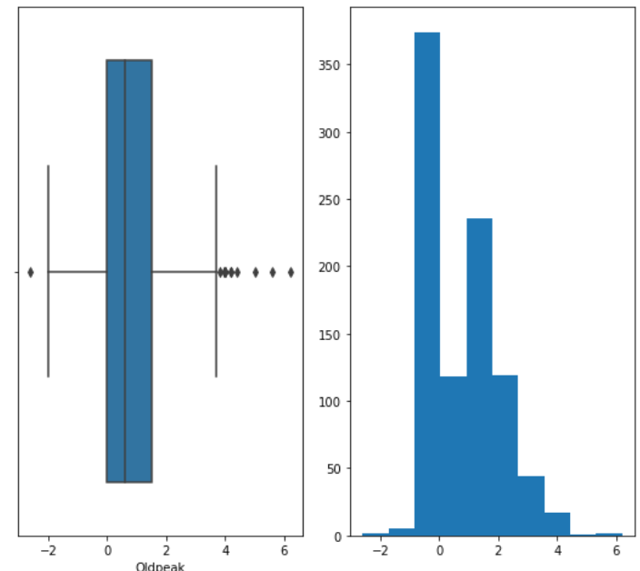
EDA
Notes:
According to the boxplots and histograms: Age: Range from 28-77. Resting BP: Resting blood pressure. MaxHR: Maximum heart rate. High MaxHR may be more likely leading to cardiovascular diseases. Cholesterol: serum cholesterol. High serum cholesterol may be more likely to lead to cardiovascular diseases. Oldpeak: Depression level. we can see that every numerical attribute except for Cholesterol are nearly normally distributed. The 'RestingBP', 'MaxHR', 'Cholesterol', and 'Oldpeak' have some outliers.

Slide 9
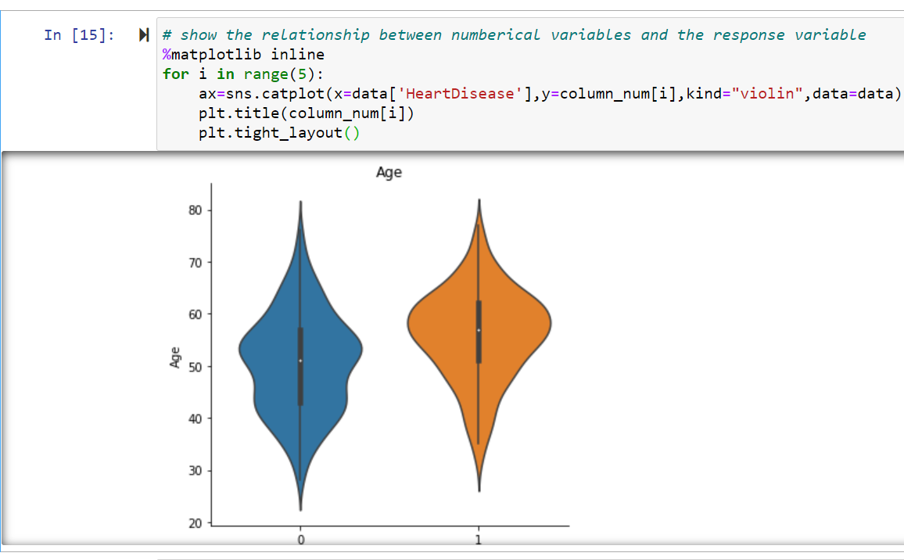
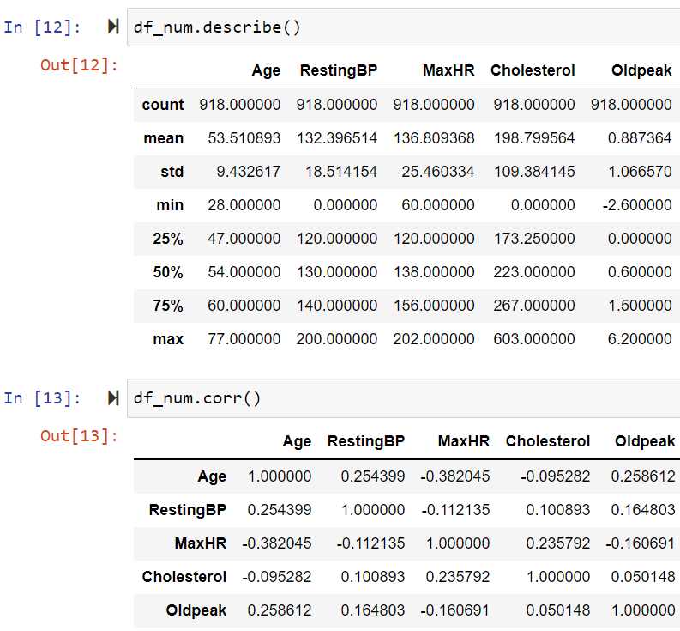
EDA
Notes:
We also showed the relationship between numerical variables and the response variable and relationship each other.
According to the violin plot and the correlation calculation:.
These attributes have a low correlation with each other.

Slide 10
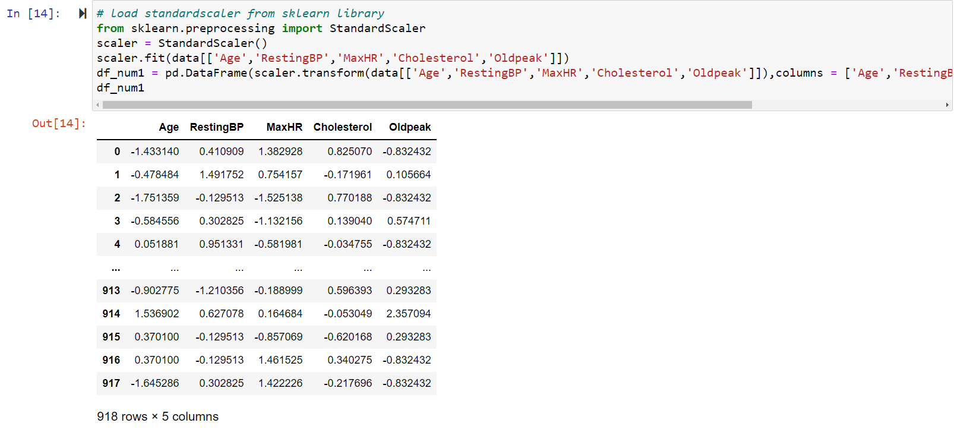
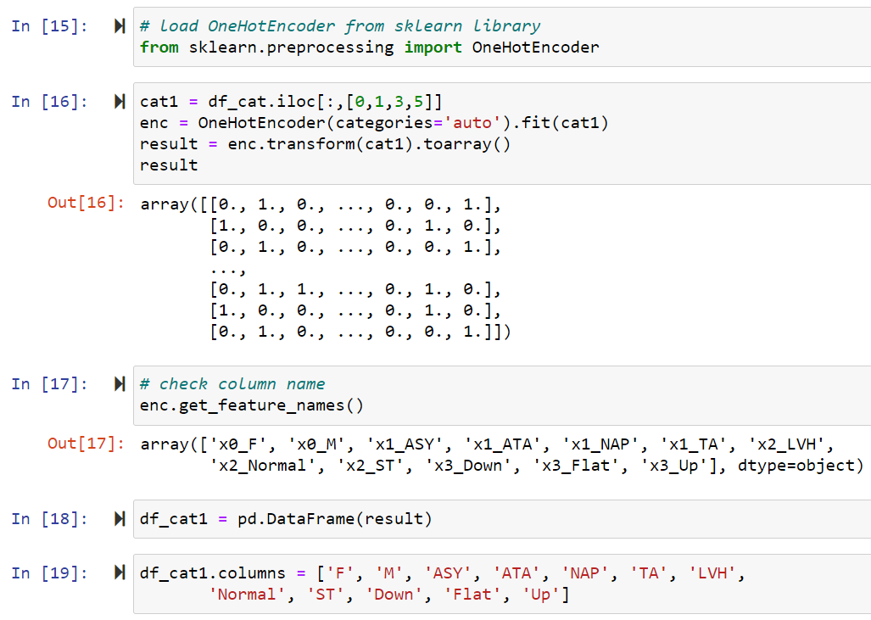
Data Preparation
Notes:
According to the result of EDA, we decide to use standardization for numerical variables and use OneHotEncoder to turn nominal categorical attributes into dummy variables.

Slide 11
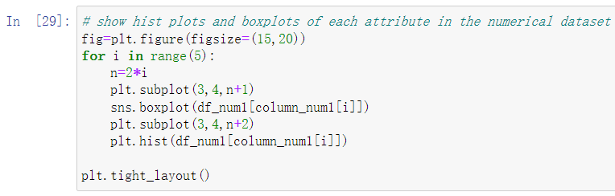
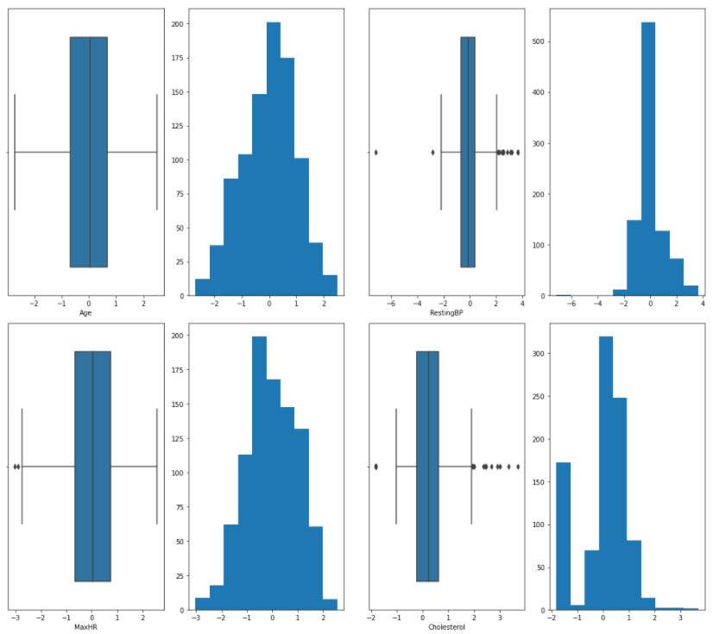
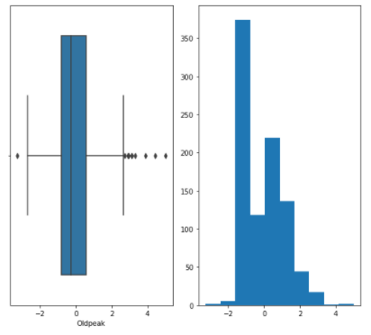
Re - EDA

Slide 12
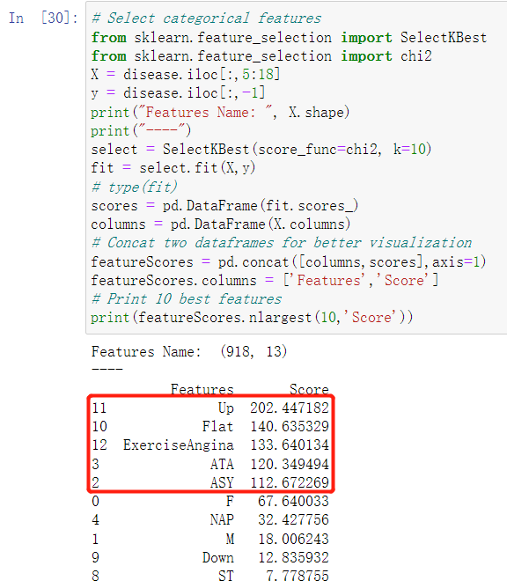
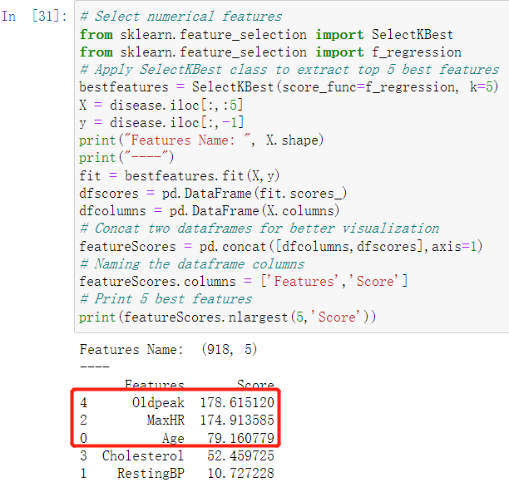
Machine Learning Models - Feature Selection

Slide 13
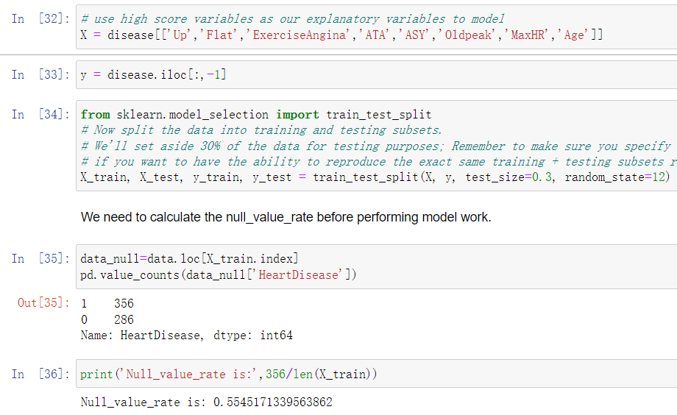
Machine Learning Models - Feature Selection

Slide 14
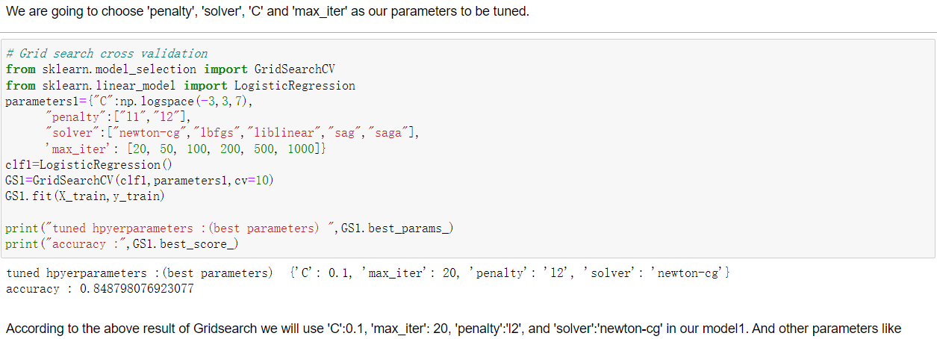
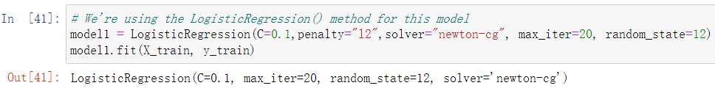
Machine Learning Models – Logistic Regression

Slide 15
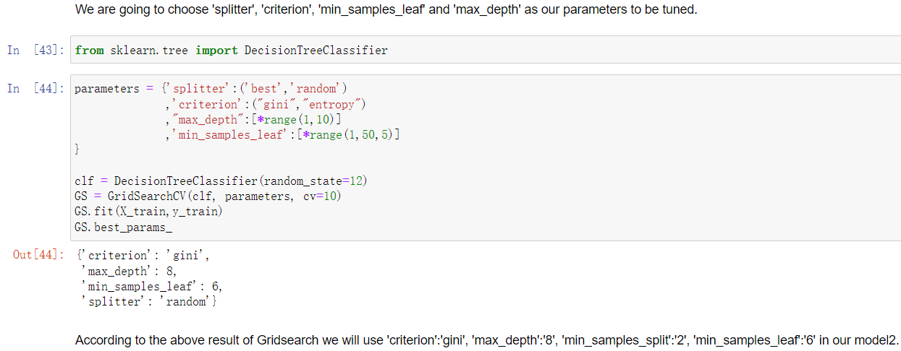
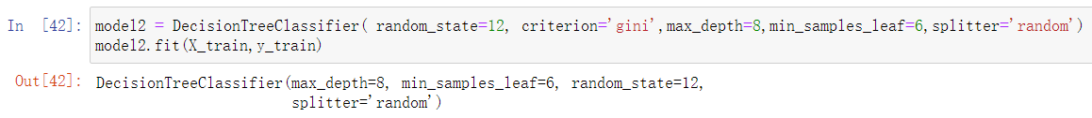
Machine Learning Models – Decision Tree

Slide 16
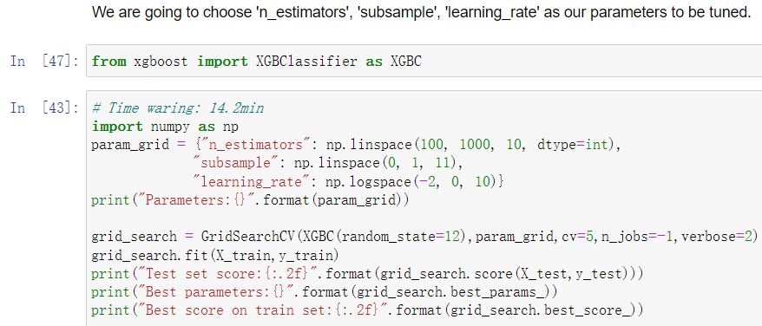
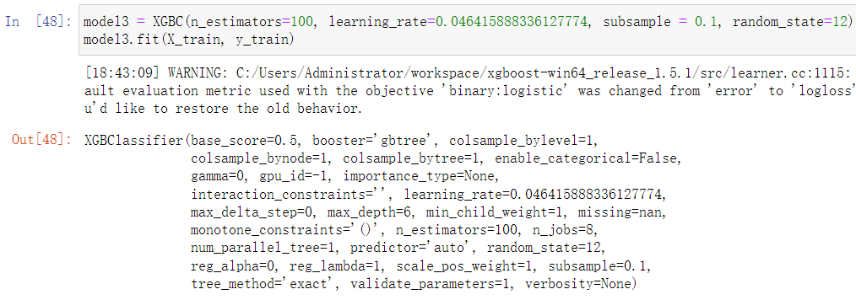
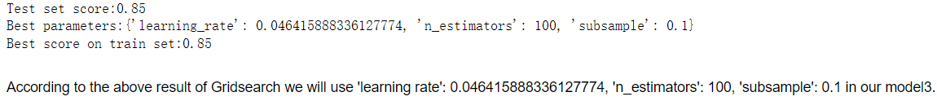
Machine Learning Models – XG Boost

Slide 17
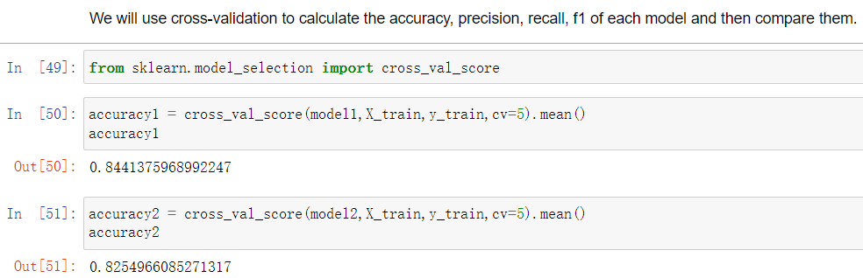
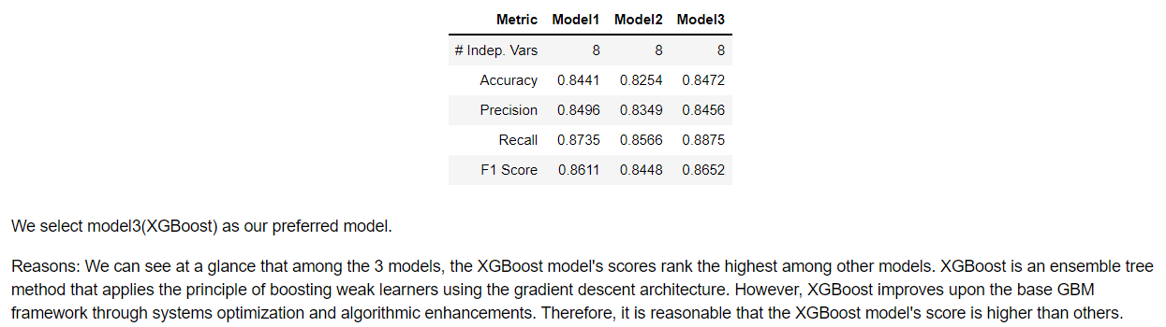
Model Selection

Slide 18
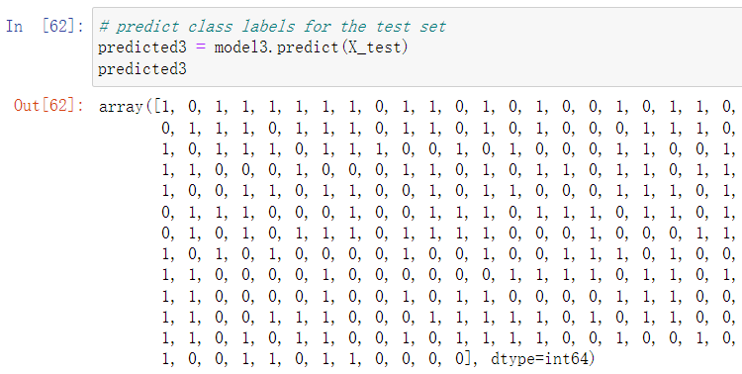
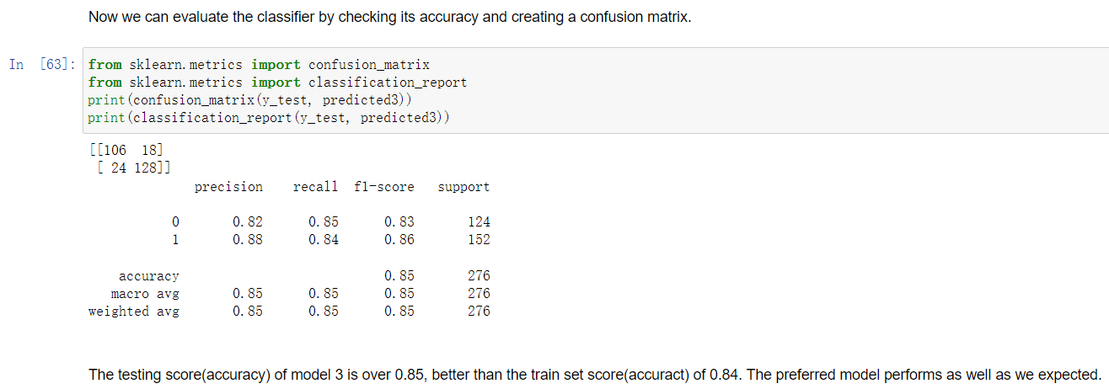
Model Selection

Slide 19
Ensemble Model
- LogisticRegression model
- Decision Tree model
- KNN classifier model
- SVM classifier model

Slide 20
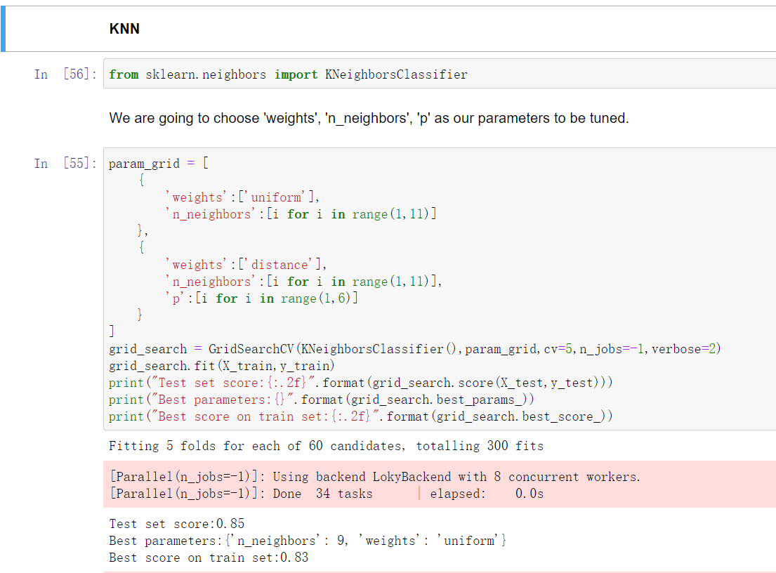
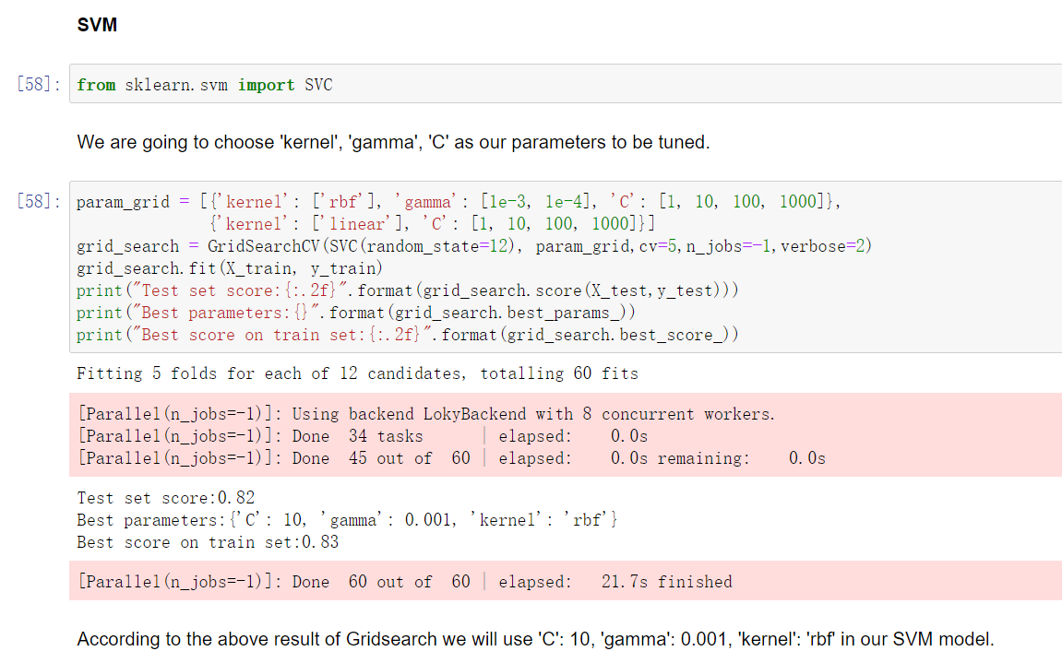
Ensemble Model – tuning hypeparameters

Slide 21
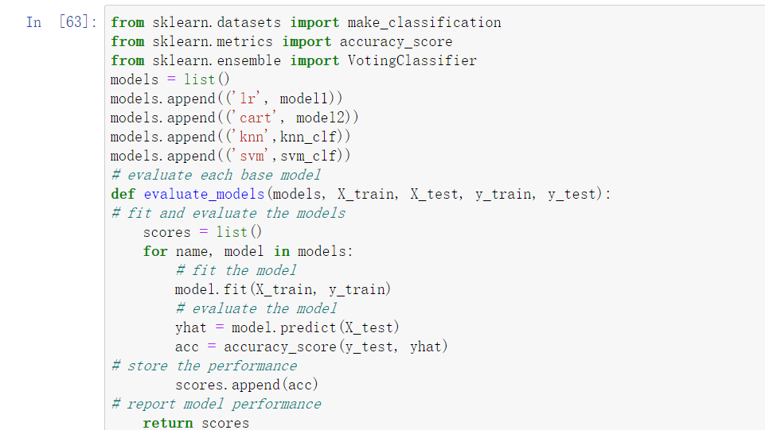
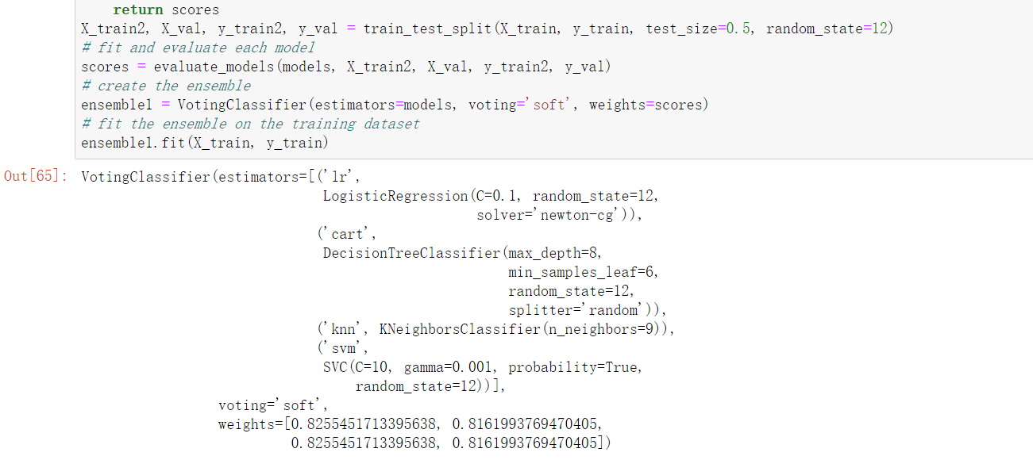
Ensemble Model – Soft Voting

Slide 22
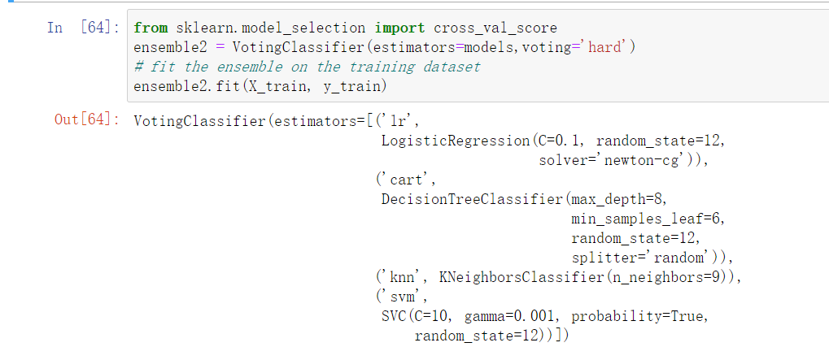
Ensemble Model – Hard Voting

Slide 23
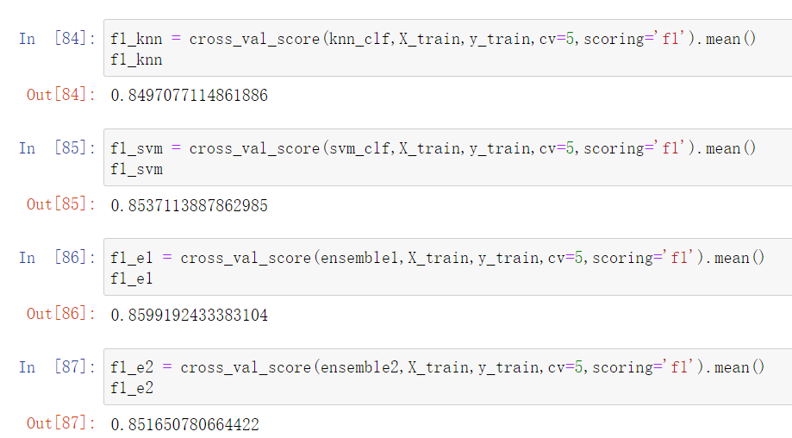
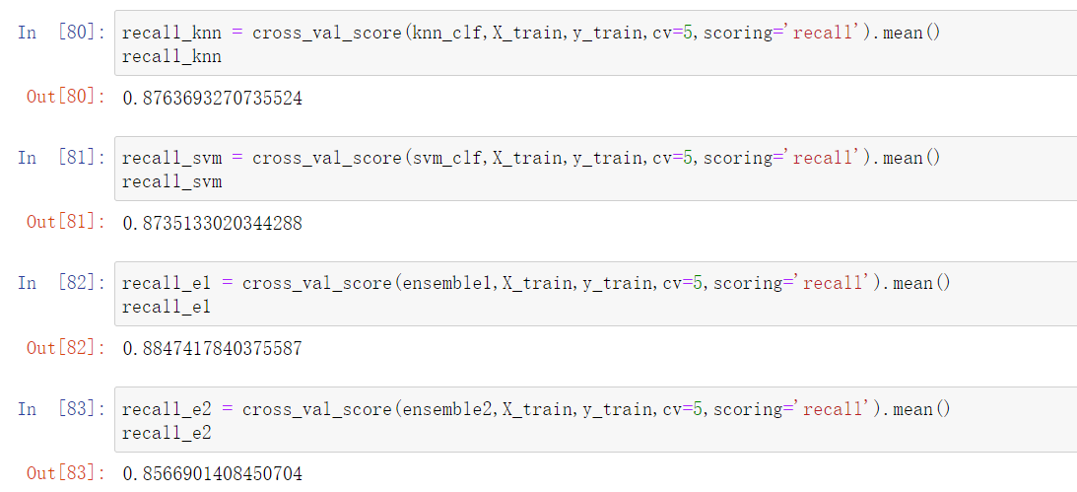
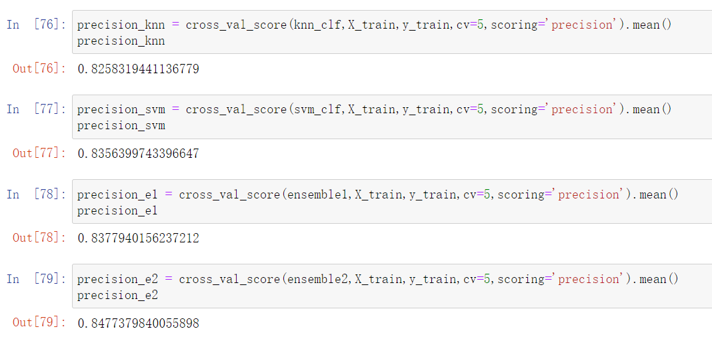
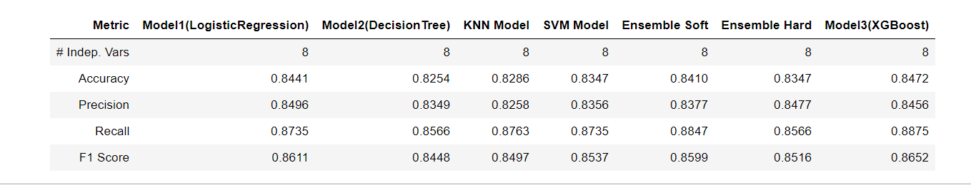
Ensemble Model

Slide 24
Conclusion
For the question1: What biological attributes can help us to construct machine learning models that can predict whether we have cardiovascular disease or not?
The chosen attributes are 'Up(ST_Slope)', 'Flat(ST_Slope)', 'ExerciseAngina', 'ATA(ChestPainType)', 'ASY(ChestPainType)',
'Oldpeak','MaxHR' and 'Age'.
For the question2: Which model is the best model to predict whether we have cardiovascular disease or not? Our response variable is 'HeartDisease'.
The best model to predict whether people have cardiovascular or not is XGBoost

Slide 25
Challenge
1. The selection of hyperparameters and their tuning.
2. Ensemble model’s score is lower than the single model.
future extension
1. Use more data and columns
2. Improve its efficiency and accuracy

